Slide 1

Multimodal LLMs Medical Visual Question Answering
By: Aishwarya Thorat Sheetal Patnaik
Notes:
Hello everyone, today I will be presenting our project on Multimodal LLMs for Medical Visual Question Answering.

Slide 2
Contents
00
01
02
03
04
05
06
07
About Us
Problem Definition
Proposed Methodology
Dataset Description
Preprocessing Steps
Experimental Design
Experimental Results
Conclusion & Future Work

Slide 3
Problem Definition
Existing Med-VQA systems struggle with handling complex queries across diverse medical images.
They lack domain-specific understanding and often provide poor explanations.
Current models also fail to retrieve relevant visual and textual context.
We aim to solve this using a multimodal RAG system with PubMedQA and SLAKE.
Notes:
Medical imaging plays a critical role in diagnosing a wide range of diseases. Whether it's an X-ray, MRI, or CT scan, these images provide essential insights that help healthcare professionals assess patients' conditions. However, interpreting these images effectively requires more than just visual analysis—it requires expertise and context.
In recent years, Vision-Language Question Answering (VLQA) systems have emerged as a promising solution to address this challenge. VLQA systems combine both image data and textual data, allowing them to interpret medical images in conjunction with patient history, clinical notes, and other relevant text. This is where our project comes in.
The goal of our project is to develop a system that can automatically answer medical queries related to medical images by integrating both image embeddings and language models. This integration can help improve the accuracy and efficiency of diagnosing complex conditions, leading to better patient care."

Slide 4
Dataset Description(PMC-VQA Data)
Image Data: Medical images (e.g., X-rays, CT scans, MRIs) depicting various diagnostic scenarios.
Text Data:
Captions: Descriptions of image contents (e.g., "Fractured femur").
Questions: Medical queries related to images (e.g., "What is shown in the image?").
Answer Choices: Multiple-choice answers related to the question.
Notes:
"The dataset we use consists of medical images and their corresponding textual data.
Image Data: This includes various medical images such as X-rays, CT scans, and MRIs.
Text Data: Each image is paired with captions describing the image, medical questions based on the image, and multiple-choice answers related to those questions.
Our model is trained using these image-caption-question pairs to answer medical queries effectively."
1,64,000

Slide 5
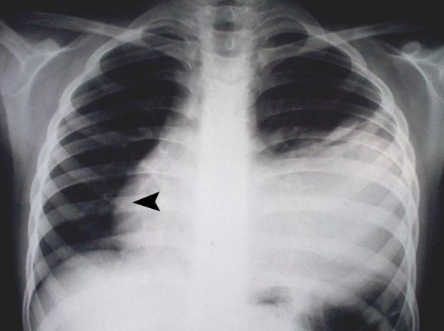
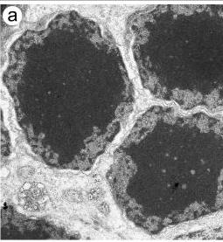
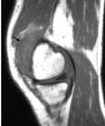
Dataset Description
Notes:
CT scans, MRI, X-rays, Ultrasound, Microscopy Pathology images
The images in the dataset include:
X-rays (shown on the left), which provide critical insights into chest conditions.
Microscopic images (shown in the middle), often used for assessing tissue and cellular structure.
MRI scans (shown on the right), which help evaluate soft tissue and bone conditions.
PMC-VQA Train 71,000
PMC-VQA Test 29,000
Slake - 4,92,000 Train 1,06,000 Test 1,05,000 Validation
PubMed - 2,11,000

Slide 6
Other Datasets
SLAKE:(RAG)
A multimodal QA dataset with 14,000 QA pairs and 642 medical images. Designed for visual understanding across different clinical image types.
PubMedQA:(RAG)
Text-only biomedical dataset with yes/no/maybe answers based on PubMed abstracts. Ideal for retrieving relevant textual evidence in medical QA tasks.
Notes:
PMC-VQA Train 71,000
PMC-VQA Test 29,000
Slake - 4,92,000 Train 1,06,000 Test 1,05,000 Validation
PubMed - 2,11,000

Slide 7
Preprocessing Steps
Image Preprocessing:
Loaded medical images from SLAKE and PMC-VQA directories.
Performed Resizing and applied standard transforms (normalization).
Text Embedding:
Tokenized and encoded PMC-VQA questions using CLIP tokenizer.
Generated dense text embeddings using openai/clip-vit-base-patch32.
Image Embedding:
Extracted image embeddings using CLIP processor.
Normalized embeddings for similarity-based retrieval.
Output:
Preprocessed image tensors and text embeddings saved for fast retrieval.
Verified shapes and ensured embedding quality for downstream RAG pipeline.

Slide 8
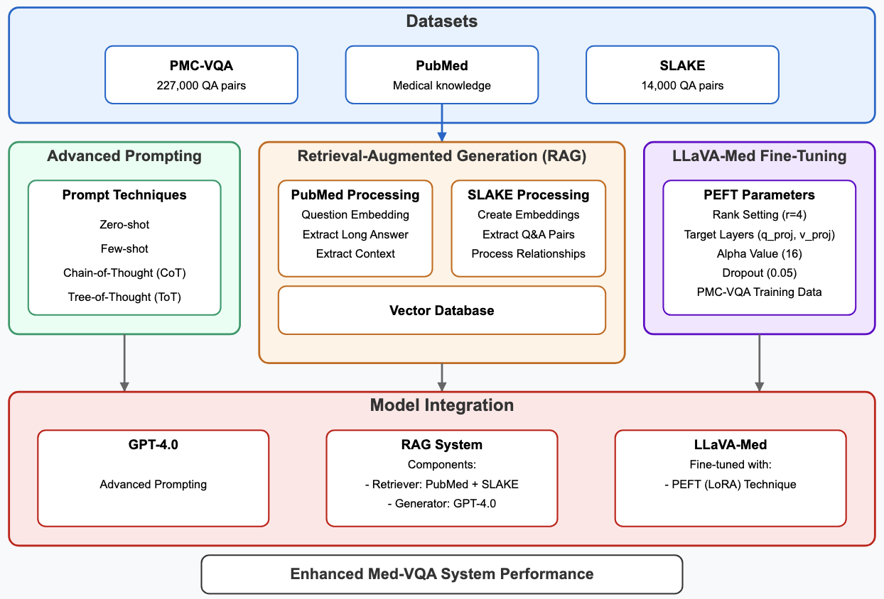
Proposed Methodology
Notes:
Alpha - How strongly these changes in parameters are affecting the final output
Target Layers - rather than making changes everywhere in the model we focused on parts which is handling attention. Model’s ability to focus on imp. Parts of image and text.
PMC-VQA Train 71,000
PMC-VQA Test 29,000
Slake - 4,92,000 Train 1,06,000 Test 1,05,000 Validation
PubMed - 2,11,000

Slide 9
Error Based Zero-Shot
Image Encoding: converted to Base64 and passed as inline inputs.
Construct Prompt: medical question and MCQ options (A-D) alongside the image.
LLM
GPT-4
Reconstruct the prompt and send it to LLM
Option Validation: Ensures response is valid (A/B/C/D)
Not Validated
Predicted Answer
Validation of both the conditions
Low Confidence Detection: Checks for phrases "I'm not sure", "can't tell"
Show response to User
Validated
Notes:
Talk Track: Error-Based Zero-Shot Process
"Now, let's take a look at the Error-Based Zero-Shot approach we used in our project. This process involves several steps to ensure that our model can effectively answer medical questions based on images without needing prior fine-tuning. Here’s how it works:
Image Encoding:
The first step is to encode the image. We convert the medical image into Base64 format and pass it as inline input to the system. This step ensures that the image can be processed alongside the text in the model.
Construct the Prompt:
Next, we construct a prompt that includes a medical question along with multiple-choice options (A-D), as well as the encoded image. This combination is used to generate the most relevant answer to the question based on the visual and textual data.
Send the Prompt to the LLM (GPT-4):
The constructed prompt is then sent to the Language Model (LLM), specifically GPT-4, for processing. The LLM generates an initial predicted answer to the question based on both the image and the text.
Option Validation:
Once the answer is generated, the next step is Option Validation. This ensures that the answer selected from the multiple-choice options (A/B/C/D) is valid. This validation helps in ensuring that the answer is not only appropriate but also aligns with the context.
Low Confidence Detection:
If the LLM is uncertain about the answer, we check for phrases like “I’m not sure” or “I can’t tell”. This is done through Low Confidence Detection. If such phrases are detected, the system can flag this and either request more information or provide a disclaimer that the answer may not be reliable.
Validation of Conditions:
If all the conditions are validated (the image and the answer), the system proceeds to show the predicted answer to the user.
Show Response to User:
Finally, once the answer is validated and confirmed, the system shows the response to the user. This completes the error-based zero-shot process, ensuring the model provides accurate and validated answers to medical queries based on the images.
This process allows the model to handle zero-shot learning, where it can answer medical queries without needing extensive training on specific datasets, making it both efficient and adaptable for various medical scenarios."

Slide 10
Extracting Relevant Examples
All Images & Q/A pairs
Embeddings using CLIP
Saved Embeddings in pickle file
User Query & Uploaded Image
Convert to embedding using CLIP
Cosine Similarity (KNN)
Top 3 relevant examples
Notes:
collected all the images and their Q/A pairs from the dataset.
Using CLIP, we converted them into embeddings and save those in a file.
When a user uploads a new query and image, we also converted that into an embedding using CLIP.
Then we used cosine similarity to compare the new query with the saved examples. to find the top 3 most relevant examples based on similarity.

Slide 11
Few Shot, CoT and ToT Prompting Techniques
Top 3 relevant examples
Prompt crafted for Few-Shot, CoT and ToT
LLM
(GPT-4)
Predicted O/P
User Query & Uploaded Image
Notes:
We passed user query and image along with top 3 relevant examples as input.
We've constrcuted the prompts for Few-Shot, Chain-of-Thought (CoT), and Tree-of-Thought (ToT) based on their specific purposes
Passed it to the LLM

Slide 12
RAG System Architecture
Knowledge Source: Dataset (Question, Context, Long Answer)
Embeddings:
Using MiniLM (384-d) sentence transformer
Vector DB:
FAISS
User Query and Uploaded Image
Embeddings:
Embedding of the Question
Retrieved Context:
Retrieved context using similarity search
Pass to LLM:
Pass the user query and retrieved context to the LLM.
Notes:
MedQuAD,MIMIC-CXR,BioASQ QA Data

Slide 13
Retrieval Process
For each PMC-VQA question:
1. Generate embedding
2. Search PubMedQA index (Top-1)
3. Retrieve matching question, context, long answer
4. Record both query and retrieved context for RAG

Slide 14
LLaVA-Med Fine Tuning with LoRA
Started with the LLaVA-1.5-7B model
Rank:
low rank (r=4)
Dropout:
dropout (0.05)
Targeting Specific Layers:
q_proj, v_proj
Accuracy
(51%)
Learning Rate (1e-4)
Alpha Value (16)
Notes:
MedQuAD,MIMIC-CXR,BioASQ QA Data

Slide 15
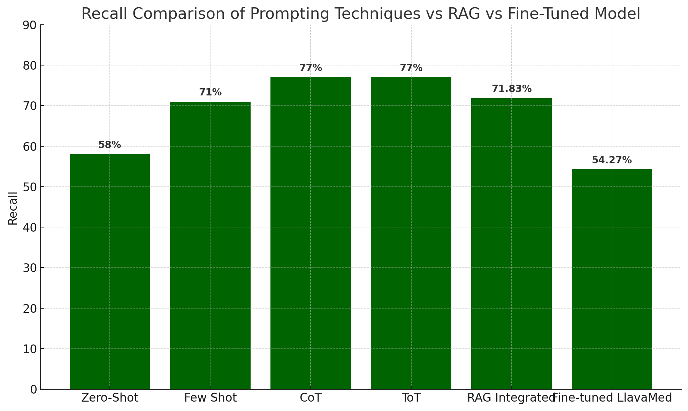
Experimental Results

Slide 16
Performance Comparison
Aspect | LLaVA-Med | Our Model
Evaluation Datasets | PathVQA, VQA-RAD, Med-VQA | PMC-VQA (primary), SLAKE, PubMedQA (for RAG)
Architecture | R-LLaVA (7B): Vision-Language model trained on biomedical data | KNN-based retrieval + GPT-4 inference + multimodal prompting
Prompting Accuracy Range | Not explicitly mentioned | 60% – 78% depending on prompting strategy
RAG-Based Accuracy | Did Not Perform | 71.83% using PubMedQA + SLAKE retrieval
Fine-Tuned Accuracy | 80.97% on VQA-Med 2019 (close-ended Qs) | 54.27% with LLaVA-Med fine-tuned on PMC-VQA

Slide 17
Conclusion
We built a multimodal RAG system that integrates image and text retrieval for medical visual question answering.
Prompting techniques like CoT and ToT outperformed fine-tuning, achieving up to 77% recall.
Improve Model Accuracy
Integrate Mixture of Experts (MoE) for enhanced domain specialization.
Future Scope
Notes:
We are planning to integrate MoE for enhanced domain specialization
build a base transformer (like BERT or BLIP).
Inside it, design expert modules (e.g., separate feedforward layers or attention heads fine-tuned for different question types).
A router decides which experts to use based on the input.
apply PEFT (like LoRA) to fine-tune just the experts.
Types of questions are like -
“What condition does the X-ray suggest?”
“Where is the abnormality located?”
What’s the difference between condition A and B?”
To implement RAG, we will:
Connect a medical knowledge source (like PubMed or a clinical database).
Retrieve relevant documents based on the question using a retriever model (like FAISS with sentence embeddings).
Feed both the question and retrieved context to a language model (like BERT or LLaMA) to generate accurate and informed answers.

Slide 18
THANK YOU

Slide 19
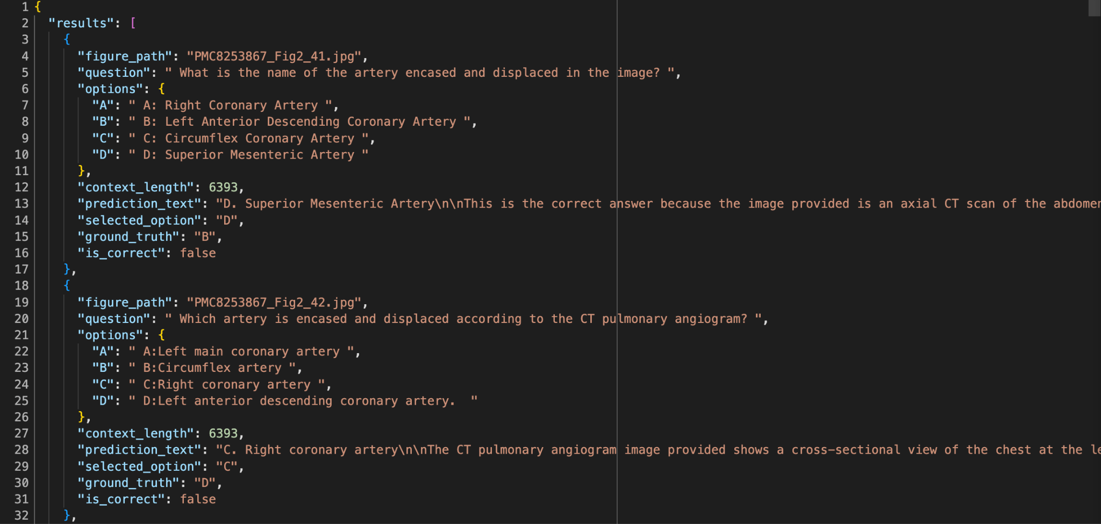
RAG

Slide 20
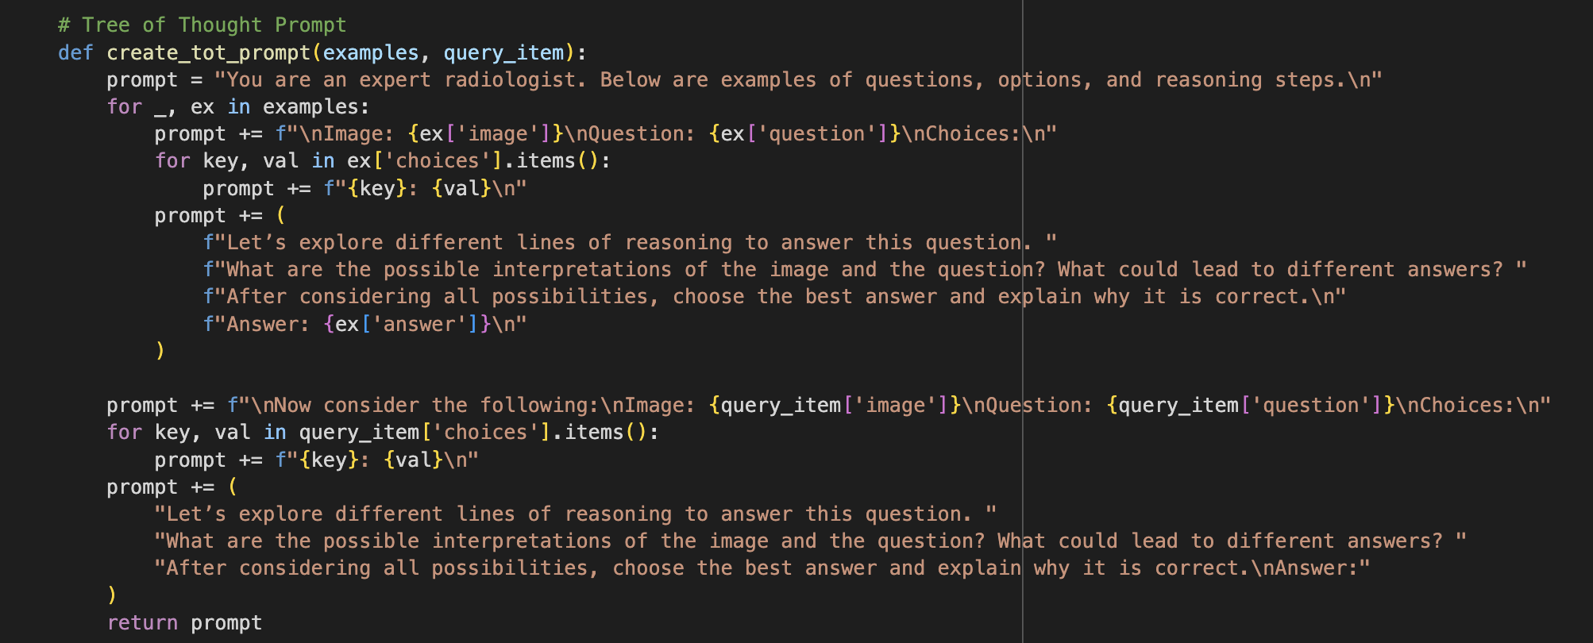
ToT

